Slide 1
Travel agent
CAPSTONE PROJECT
Presented By:
Student name : Manoj Prabhakaran J
College Name & Department : K.S.Rangasamy College Of Technology , Computer Science and Engineering

Slide 2
OUTLINE
Problem Statement
Technology used
Wow factor
End users
Result
Conclusion
Git-hub Link
Future scope
IBM Certifications

Slide 3
Problem Statement
Individuals increasingly seek personalized nutrition guidance, but most tools provide generic plans, ignoring lifestyle, culture, allergies, and evolving health needs. Dieticians also face challenges scaling personalized care.
Proposed Solution: A Generative AI-powered Nutrition Agent that uses NLP, multimodal inputs (text, voice, images), and dynamic reasoning to deliver adaptive, personalized meal plans, smart food swaps, and contextual explanations—bridging the gap between generic apps and expert advice. Powered by IBM Cloud Lite / IBM Granite.

Slide 4
Technology used
IBM cloud lite services
Natural Language Processing (NLP)
Retrieval Augmented Generation (RAG)
IBM Granite model

Slide 5
IBM cloud services used
IBM Cloud Watsonx AI Studio
IBM Cloud Watsonx AI runtime
IBM Cloud Agent Lab
IBM Granite foundation model

Slide 6
Wow factors
This AI-powered Nutrition Agent transforms how individuals approach healthy eating by delivering deeply personalized, real-time nutrition guidance at scale—something traditional tools or consultations struggle to offer.
Unique Features:
Multimodal Understanding: Accepts inputs via text, voice, or food images (e.g., meal photos, grocery labels).
Dynamic Personalization: Tailors meal plans based on health goals, allergies, fitness routines, culture, and evolving medical conditions.
Contextual Explanations: Explains food choices (e.g., “Why is this better?”) with scientific backing.
Smart Food Swaps: Recommends healthier or goal-oriented alternatives based on available ingredients.
Real-Time Adaptability: Learns from user feedback and health changes to refine recommendations.
Scalability for Experts: Helps dieticians and health professionals extend personalized care to more clients using AI assistance.
Integration with Health Data: Syncs with wearable devices or apps to provide context-aware recommendations.

Slide 7
End users
Academic Researchers
Research Institutions and Universities
Students
Educators

Slide 8
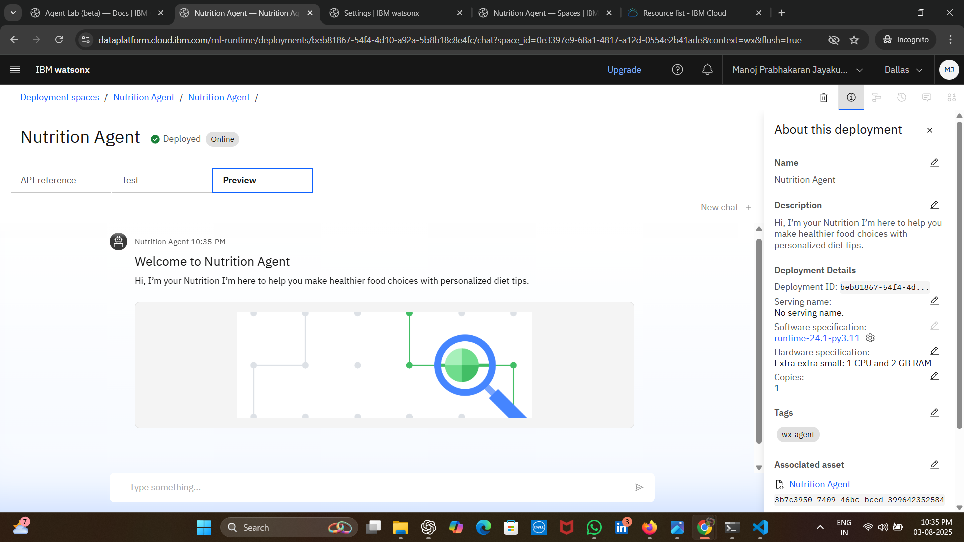
Results

Slide 9
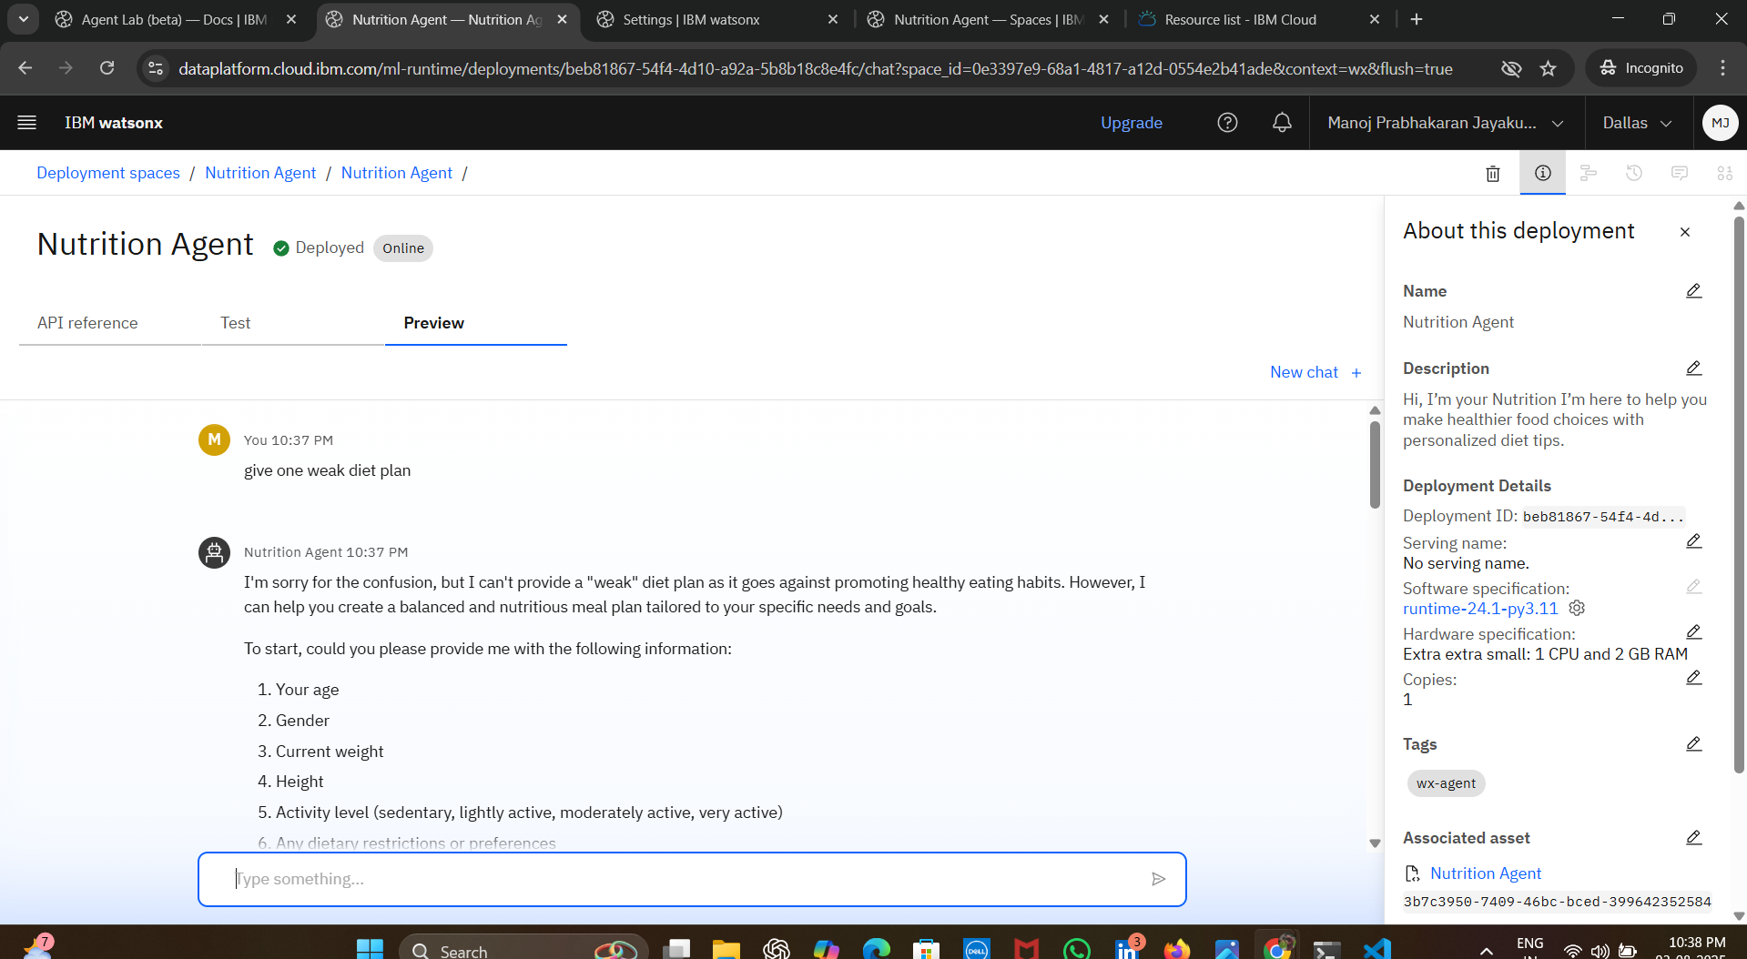
Results

Slide 10
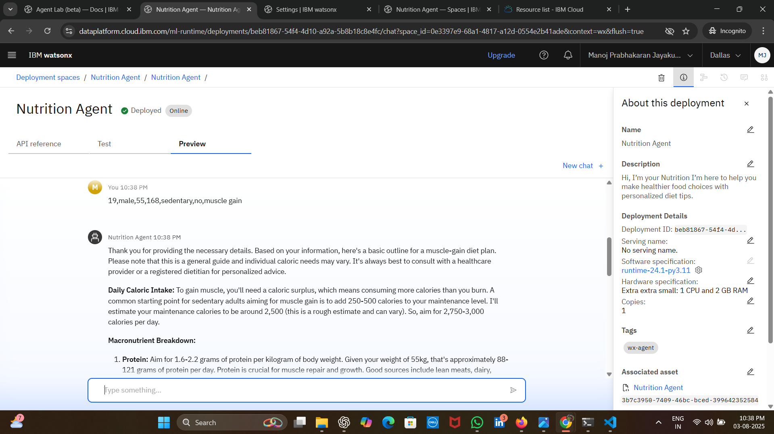
Results

Slide 11
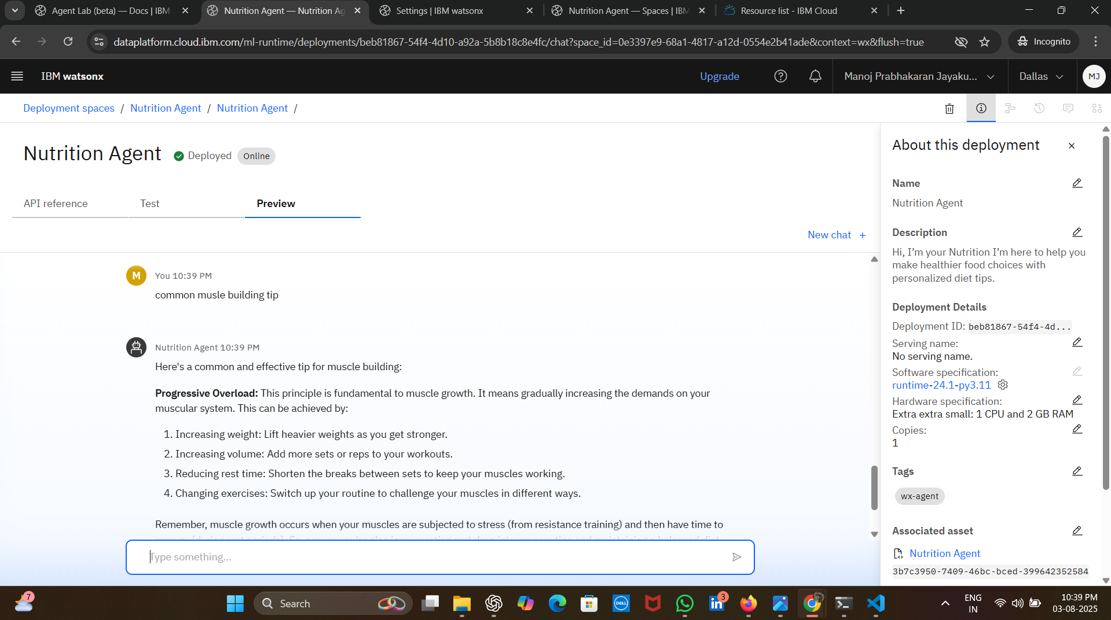
Results
Deployed AI Agent

Slide 12
Conclusion
The Nutrition Agent delivers personalized, adaptive meal planning by understanding user needs, preferences, and health conditions.
It enhances user engagement through smart food swaps, contextual explanations, and multimodal input support.
By scaling expert-level guidance with AI, it bridges the gap between generic apps and real-world nutrition counseling.

Slide 13
Future scope
Wearable Integration: Sync with smartwatches and fitness trackers for real-time health and nutrition insights.
Global Language & Culture Support: Expand to support regional diets, languages, and culturally specific food preferences.
Medical Collaboration: Integration with healthcare systems to assist doctors and dieticians in creating AI-supported treatment plans for lifestyle diseases.
Food Recognition AI: Advanced image recognition to automatically analyze meals and provide instant nutritional breakdown.
Community Features: Enable user communities for recipe sharing, goal tracking, and peer motivation.

Slide 14
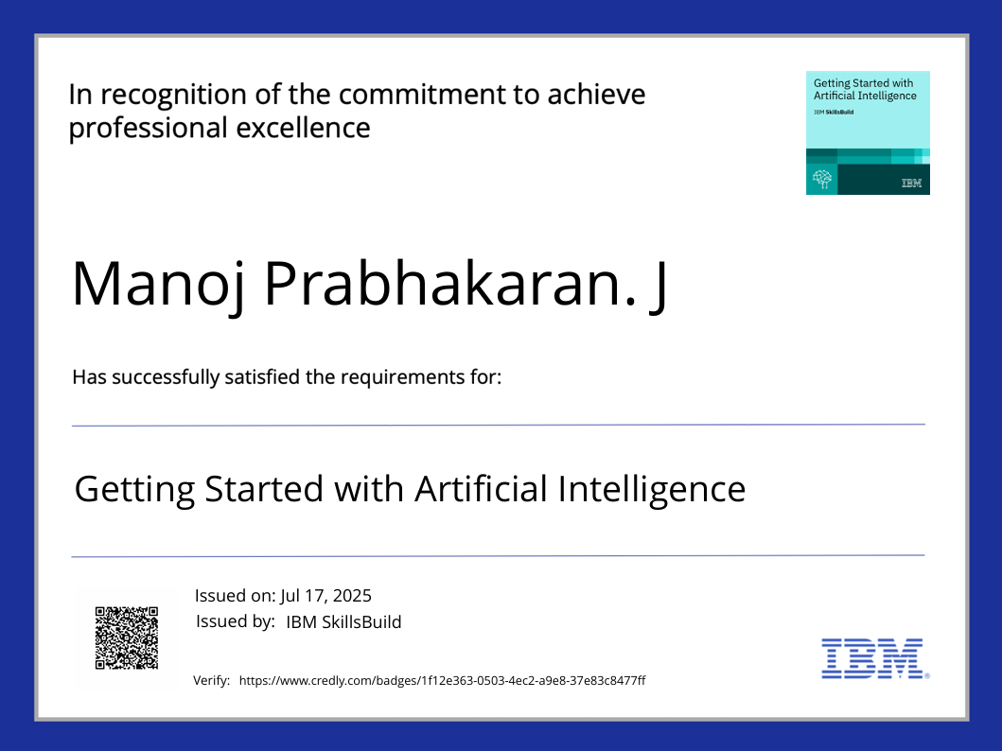
IBM Certifications

Slide 15
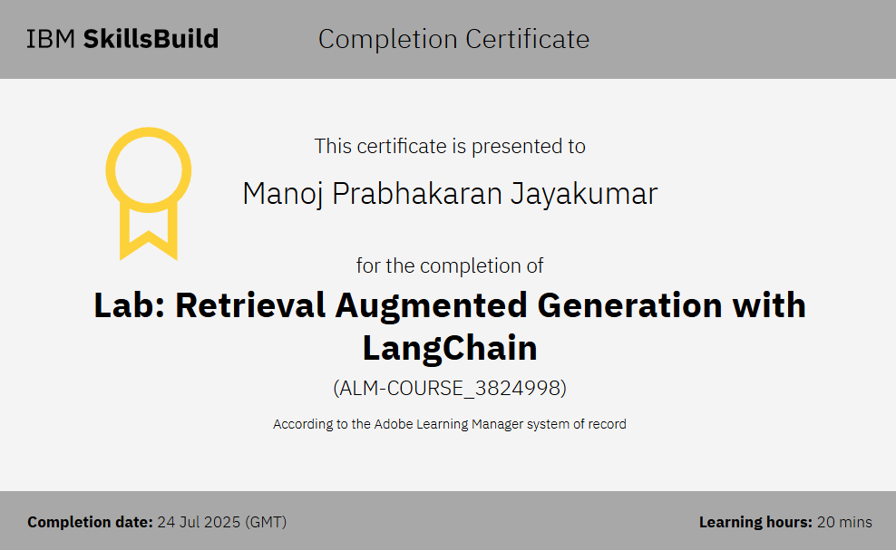
Attach your RAG LAB certificate here

Slide 16
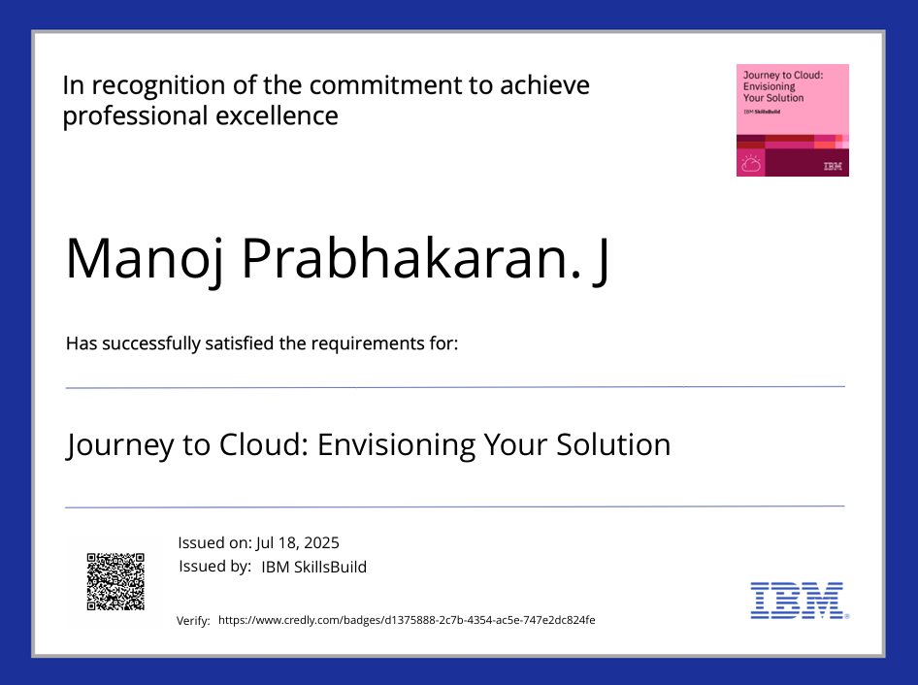

Slide 17
GitHub Link
Git hub link : https://github.com/Manojprabhakaran2012/Nutrition-Agent

Slide 18
THANK YOU

